Slide 1
Encoder-Decoder and Auto-Encoder
Li Hao
Dong Kaixing
Notes:
http://www.deeplearningbook.org/contents/autoencoders.html
Output
- idea of compressions
-audoencoder
- application
retrieval
image
-also as initilization

Slide 2
Unsupervised Learning
“We expect unsupervised learning to become far more important in the longer term. Human and animal learning is largely unsupervised: we discover the structure of the world by observing it, not by being told the name of every object.” – LeCun, Bengio, Hinton, Nature 2015
Notes:
櫻桃梗

Slide 3
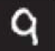
Auto-encoder
Usually <784
Compact representation of the input object
NN
Encoder
code
28 X 28 = 784
Learn together
Can reconstruct the original object
code
NN
Decoder

Slide 4
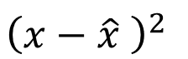
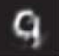
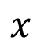
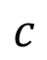
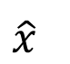
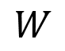
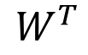
Recap: PCA
Minimize
As close as possible
encode
decode
hidden layer
(linear)
Input layer
output layer
Bottleneck later
Output of the hidden layer is the code
Notes:
A neutral net whose output tries to reconstruct the input
Target of output (�� ̂) = input (��)

Slide 5
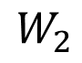
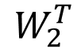
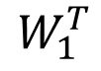
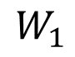
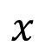
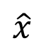
Deep Auto-encoder
Symmetric is not necessary.
Of course, the auto-encoder can be deep
As close as possible
…
Layer
…
Layer
Output Layer
Input Layer
Layer
bottle
Layer
Layer
Layer
Code
Reference: Hinton, Geoffrey E., and Ruslan R. Salakhutdinov. "Reducing the dimensionality of data with neural networks." Science 313.5786 (2006): 504-507
Notes:
codes

Slide 6
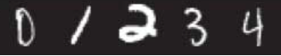
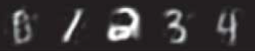
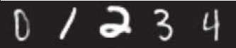
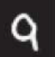
Deep Auto-encoder
Original Image
784
30
784
PCA
Deep
Auto-encoder
784
1000
500
250
30
250
500
784
1000
Notes:
Hand-written digits
Deep auto-encoder has better reconstruction capability

Slide 7
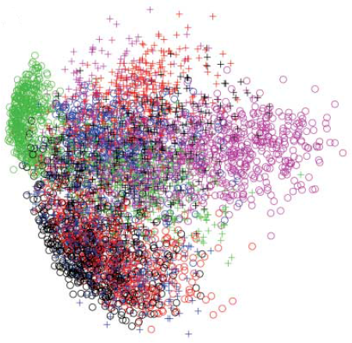
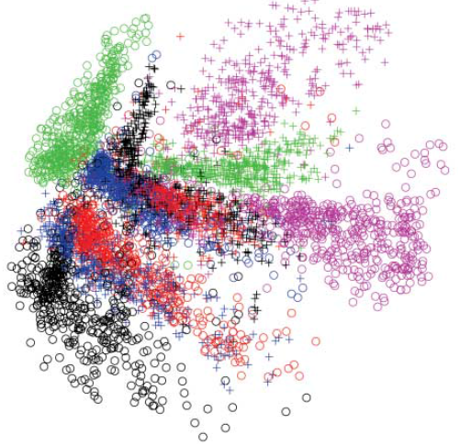
784
2
784
784
1000
500
250
2
250
500
784
1000
Notes:
From 30 to 2

Slide 8
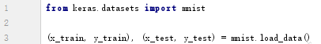
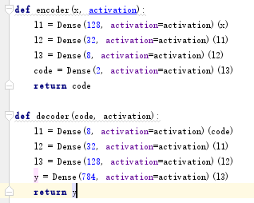
Load MNIST Data
Encoder-Decoder Network

Slide 9
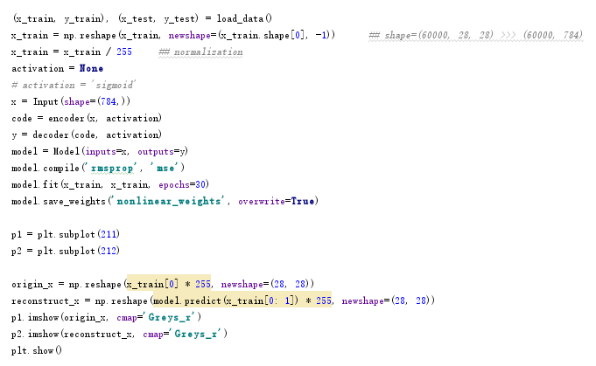
Auto-Encoder Network

Slide 10
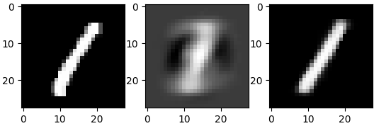
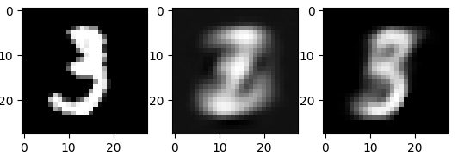
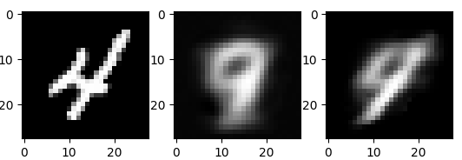
Origin Linear Sigmoid

Slide 11
What would happen if code dimension decreases to 1?

Slide 12
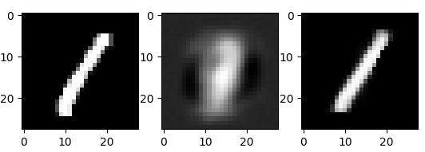
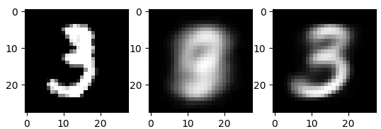
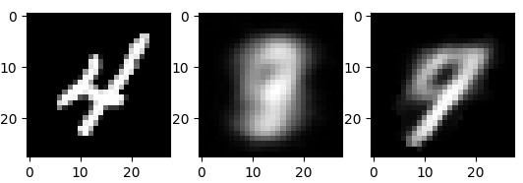
What would happen if code dimension decreases to 1?
dimension=1
dimension=2

Slide 13
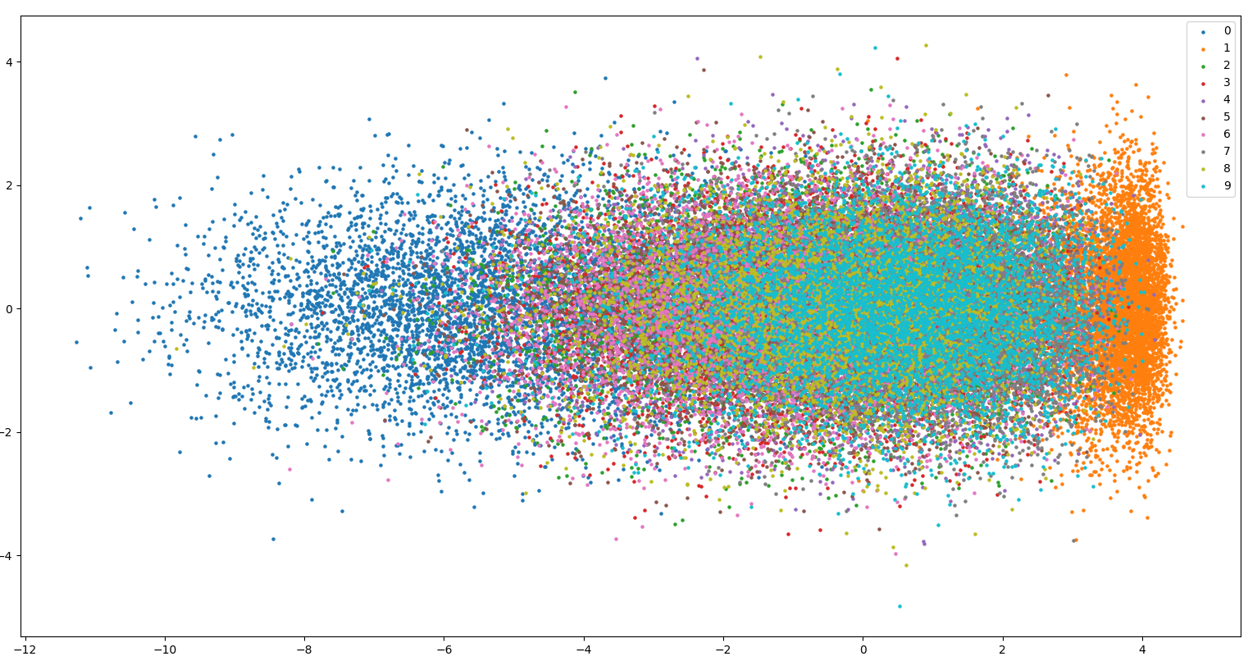
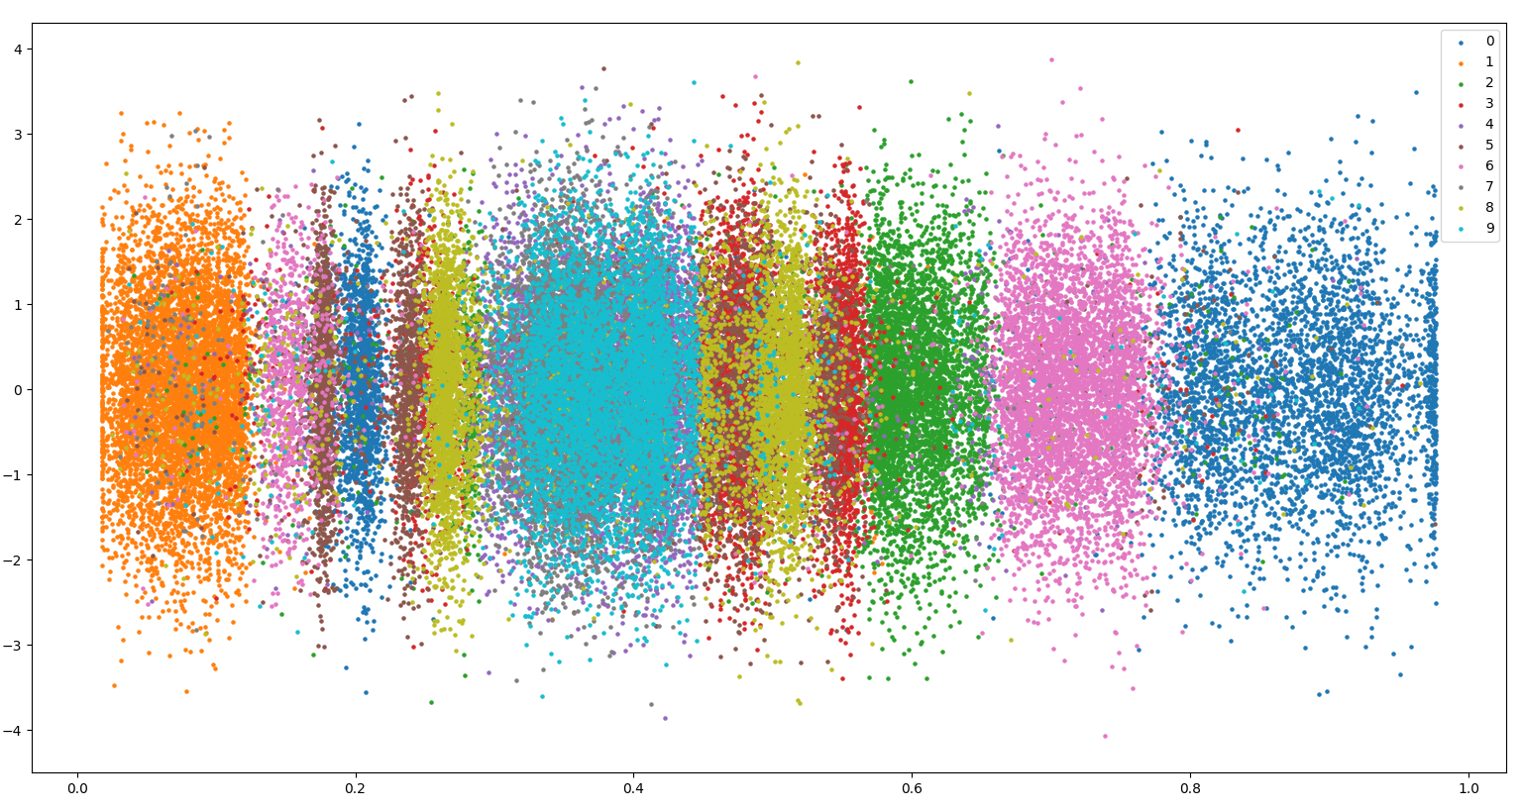
linear
sigmoid

Slide 14
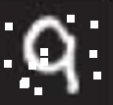
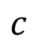
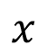
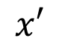
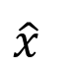
Auto-encoder
More: Contractive auto-encoder
Ref: Rifai, Salah, et al. "Contractive auto-encoders: Explicit invariance during feature extraction.“ Proceedings of the 28th International Conference on Machine Learning (ICML-11). 2011.
De-noising auto-encoder
As close as possible
encode
decode
Add noise
Vincent, Pascal, et al. "Extracting and composing robust features with denoising autoencoders." ICML, 2008.
Notes:
有收縮性的

Slide 15
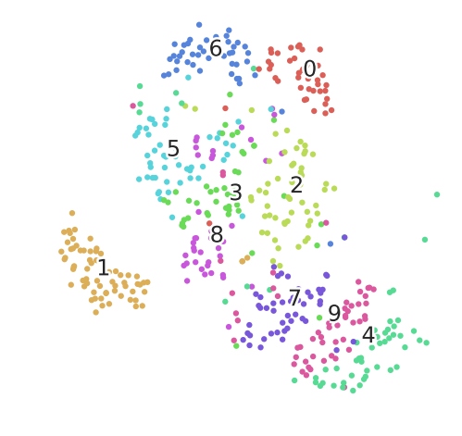
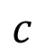
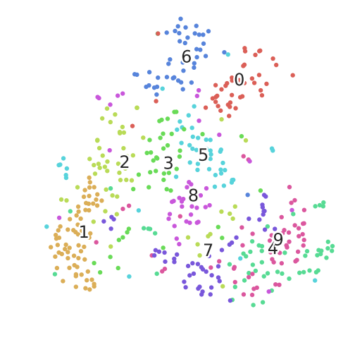
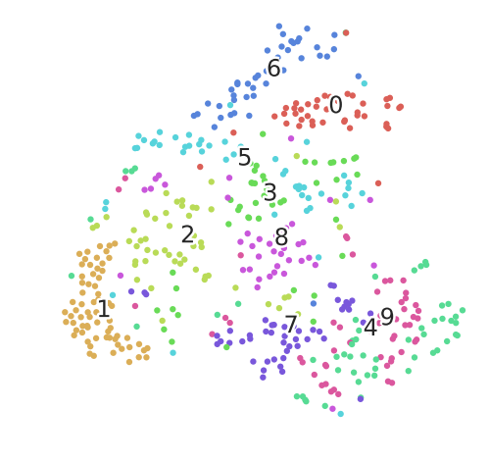
Deep Auto-encoder - Example
NN
Encoder
PCA 降到32-dim
Pixel -> tSNE

Slide 16
Homework
Implement de-noising auto-encoder.
Run MNIST recognition experiments using original pixel, auto-encoder and de-noising auto-encoder respectively.
Compare the results.

Slide 17
Auto-encoder – Text Retrieval
Vector Space Model
Bag-of-word
this
1
is
1
word string:
“This is an apple”
query
a
0
an
1
apple
1
pen
0
document
…
Semantics are not considered.
Notes:
idf

Slide 18
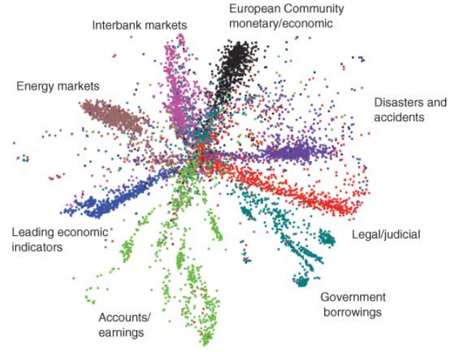
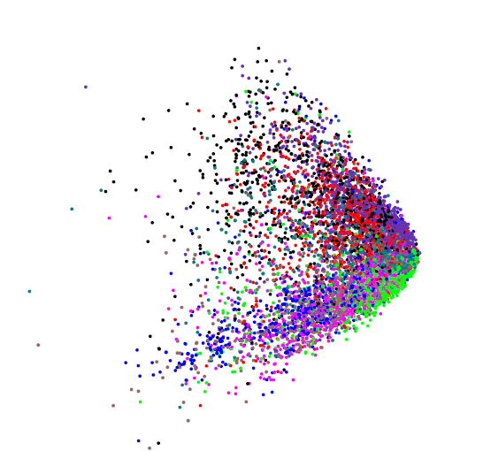
Auto-encoder – Text Retrieval
The documents talking about the same thing will have close code.
2
query
125
250
500
2000
LSA: project documents to 2 latent topics
Bag-of-word
(document or query)
Science 2006
Notes:
The qeruy not always have the common word

Slide 19
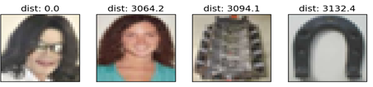
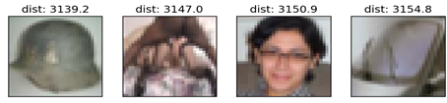
Auto-encoder – Similar Image Search
Retrieved using Euclidean distance in pixel intensity space
(Images from Hinton’s slides on Coursera)
Reference: Krizhevsky, Alex, and Geoffrey E. Hinton. "Using very deep autoencoders for content-based image retrieval." ESANN. 2011.
Notes:
Direct compute on pixel label is slow!

Slide 20
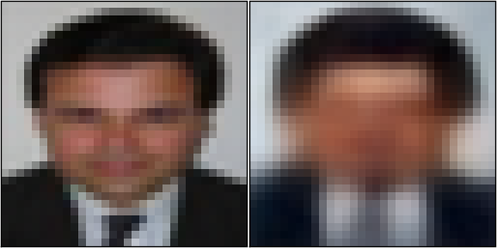
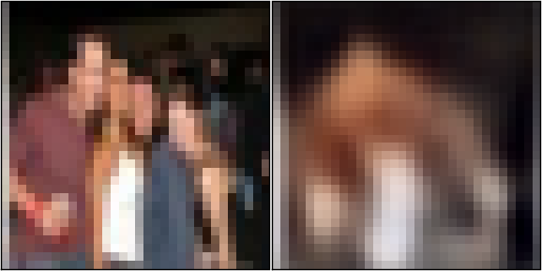


Auto-encoder – Similar Image Search
code
8192
2048
1024
512
256
4096
32x32
(crawl millions of images from the Internet)
Notes:
Reconstructions of 32x32 color images from 256-bit codes

Slide 21
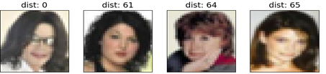
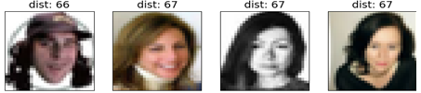
Retrieved using Euclidean distance in pixel intensity space
retrieved using 256 codes
Notes:
faster

Slide 22

Auto-encoder for CNN
As close as possible
Deconvolution
Unpooling
Convolution
Deconvolution
Pooling
Unpooling
Convolution
code
Deconvolution
Pooling
Notes:
這個圖可能有問題!

Slide 23
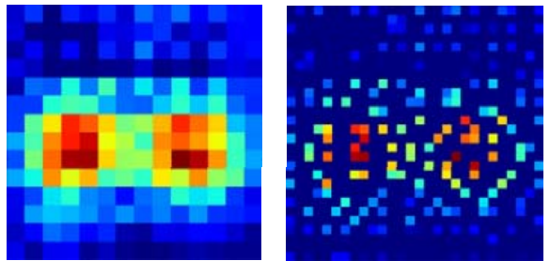
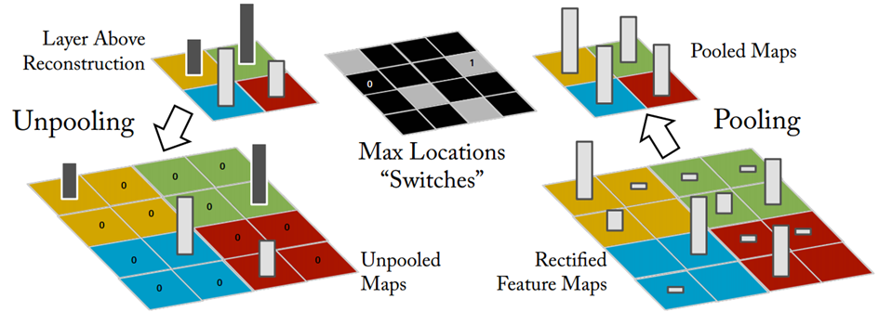
CNN -Unpooling
14 x 14
28 x 28
Alternative: simply repeat the values
Source of image : https://leonardoaraujosantos.gitbooks.io/artificial-inteligence/content/image_segmentation.html

Slide 24
CNN - Deconvolution
Actually, deconvolution is convolution.
+
+
+
=
+

Slide 25


Auto-encoder – Pre-training DNN
Greedy Layer-wise Pre-training again
output
10
500
Target
1000
784
W¹’
1000
1000
W¹
Input
784
Input
784

Slide 26



Auto-encoder – Pre-training DNN
Greedy Layer-wise Pre-training again
output
10
500
1000
W²’
Target
1000
1000
W²
1000
1000
fix
W¹
Input
784
Input
784

Slide 27


Auto-encoder – Pre-training DNN
Greedy Layer-wise Pre-training again
output
10
1000
W³’
500
500
W³
Target
1000
1000
fix
W²
1000
1000
fix
W¹
Input
784
Input
784

Slide 28
Auto-encoder – Pre-training DNN
Find-tune by backpropagation
Greedy Layer-wise Pre-training again
output
10
output
10
Random init
W⁴
500
500
W³
Target
1000
1000
W²
1000
1000
W¹
Input
784
Input
784

Slide 29


Next …..
code
NN
Decoder
Can we use decoder to generate something?
Notes:
SOM: http://alaric-research.blogspot.tw/2011/02/self-organizing-map.html

Slide 30

Neural MachineTranslation seq2seq
Traditional phrase-based translation systems
Break up
Phrase-by-phrase
NMT(mimic humans)
Break up
phrase-by-phrase

Slide 31

Neural machine translation-Training
Embedding(word2vec …)
encoder_inputs
decoder_inputs

Slide 32
Neural machine translation-Training
Embedding
encoder
RNN …

Slide 33
Neural machine translation-Training
Embedding
encoder
decoder
RNN …

Slide 34
Neural machine translation-Training
Embedding
encoder
decoder
projection
Dense

Slide 35
Neural machine translation-Training
Embedding
encoder
decoder
Projection
Loss
decoder_output
target_output

Slide 36
Neural machine translation-Training
Embedding
encoder
decoder
Projection
Loss

Slide 37

Inference – How to generate translations
Greedy decoding
Heuristic stop strategy
(source_sequence_length) * 2

Slide 38
Neural MachineTranslation Attention Mechanism
Encoder last state
Other Hidden State

Slide 39

Neural MachineTranslation-Training Attention Mechanism

Slide 40


Neural MachineTranslation-Training Attention Mechanism

Slide 41

Neural MachineTranslation-Training Attention Mechanism
(Neural Machine Translation by Jointly Learning to Align and Translate 2015. Bahdanau at al.)

Slide 42
Neural MachineTranslation-Training Attention Mechanism

Slide 43
Neural MachineTranslation-Training Attention Mechanism

Slide 44
Neural MachineTranslation-Training Attention Mechanism
Input-feeding Approach
(a) we hope to make the model fully
aware of previous alignment choices
(b) we create a very deep network
spanning both horizontally and vertically.
(Effective Approaches to Attention-based Neural Machine Translation 2015.Luong at al.)

Slide 45
Assignment
Read paper ‘Sequence to Sequence Learning with Neural Networks 2014 Sutskever at al.’and implement simple seq2seq model.
Requirements:
Implement the simple seq2seq model.
Add Attention Mechanism to your model if you find no challenging.
Supplementary:
You can implement this model with any framework you like: Keras, Tensorflow and Pytorch are suggested.
If you have any problems implementing the model, you can find examples in google by searching for: “Seq2Seq Tensorflow”, the following is an example in tensorflow: https://github.com/ematvey/tensorflow-seq2seq-tutorials

Slide 46


Stock Prediction
Reference: Yao Qin, Dongjin Song, Haifeng Cheng, Wei Cheng, Guofei Jiang. "A Dual-Stage Attention-Based Recurrent Neural Network for Time Series Prediction" IJCAI-2017

Slide 47

Stock Prediction

Slide 48
THANK YOU!

